Slide 1
LithoGAN: End-to-End Lithography Modeling with Generative Adversarial Networks
Wei Ye, Mohamed Baker Alawieh, Yibo Lin, and David Z. Pan
ECE Department
The University of Texas at Austin

Slide 2
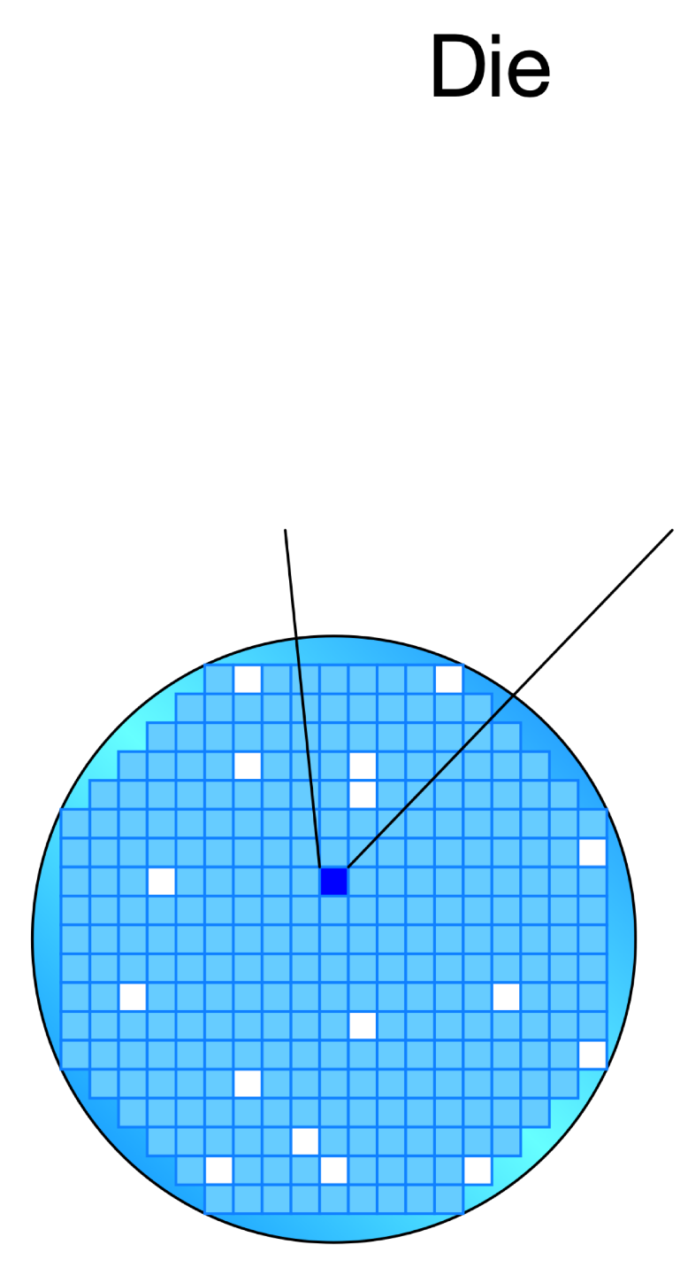
Bottleneck in IC Manufacturing: Lithography
What you see (at design) is NOT what you get (at fab)
Need to make sure design is manufacturable with high yield
Notes:
In IC manufacturing, lithography is the keystone, and also the bottleneck.
Let’s first have a look at how chip is manufactured from design.
In a lithography system, the light source projects light on the photomask to pattern the design on the wafer.
On the top of the wafer, the resist pattern will then be formed accordingly after exposed to light.
Due to the physical property of photoresist, from design target to wafer, what you see is not necessary what you get, and sometimes the mask design is not manufacturable at all.
The key point here is that Need to make sure design is manufacturable with high yield,
------
the silicon wafer is aligned with the photomask, and has photoresist on top of it.
It is not possible to make perfect manhattan polygon due

Slide 3
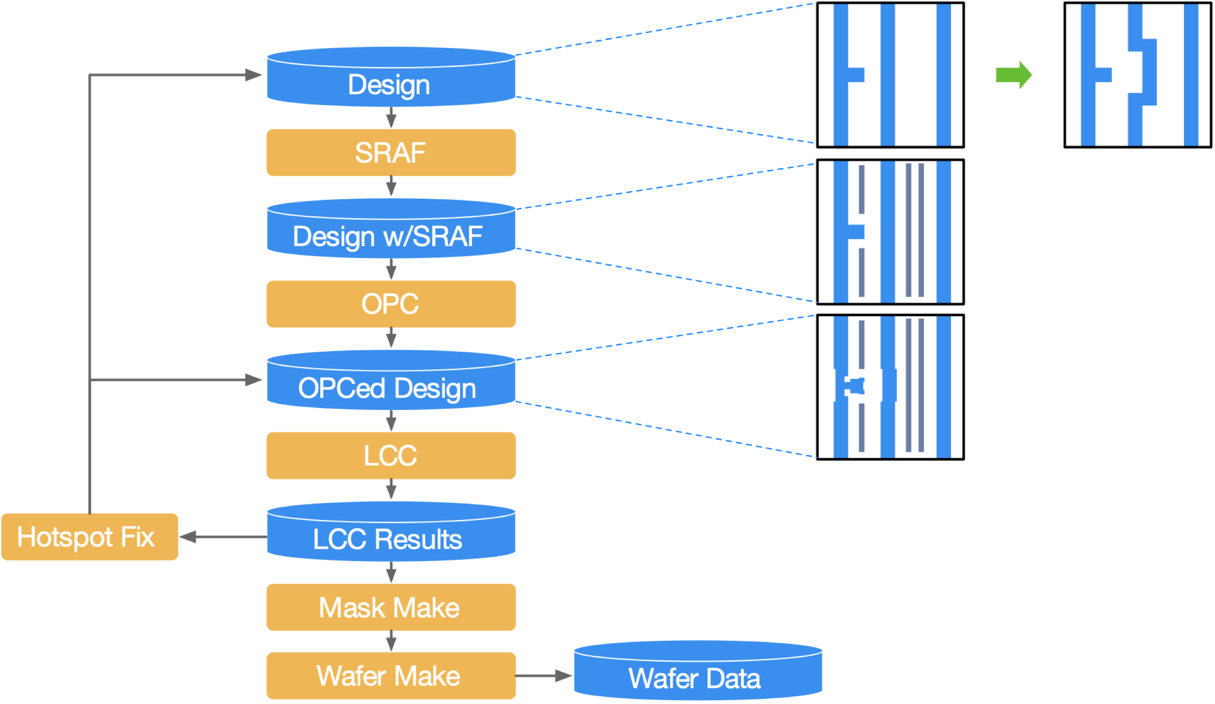
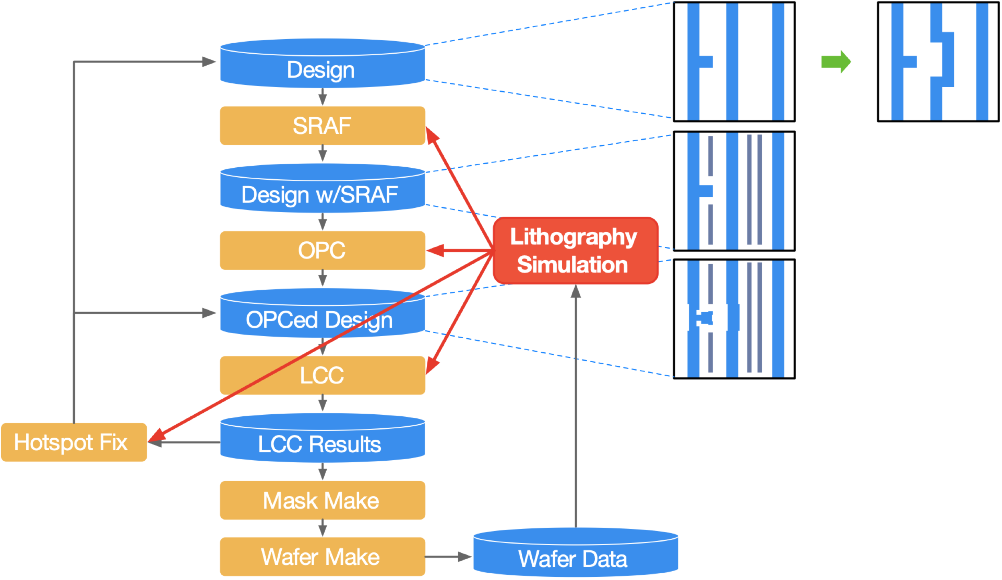
Design and Manufacturing w/ Lithography Model
Fast & accurate lithography model is highly desirable
SRAF: Sub-Resolution Assist Feature
OPC: Optical Proximity Correction
LCC: Lithography Compliance Check
[Courtesy Toshiba]
Notes:
Here we show the design for manufacturing flow, which tries to bridge the design and manufacturing gap.
For the raw design. SRAF insertion and OPC are performed, and later Lithography Compliance Check is run on design to see if it is ready for manufacturing.
[click]
Lithography simulation is used intensively during the DFM flow.
The wafer data obtained after wafer make can help calibrate the model for lithography simulation.
Since it’s used so many times in the entire flow,
Accurate lithography modeling is critical to guarantee yield, but time consuming as well, to speed up the entire flow

Slide 4
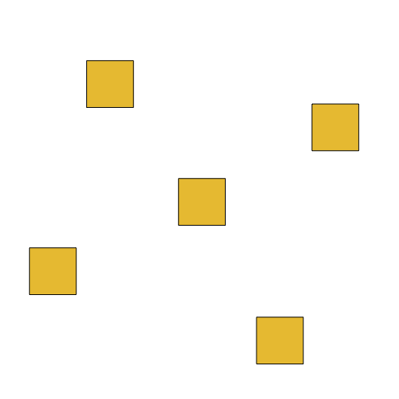
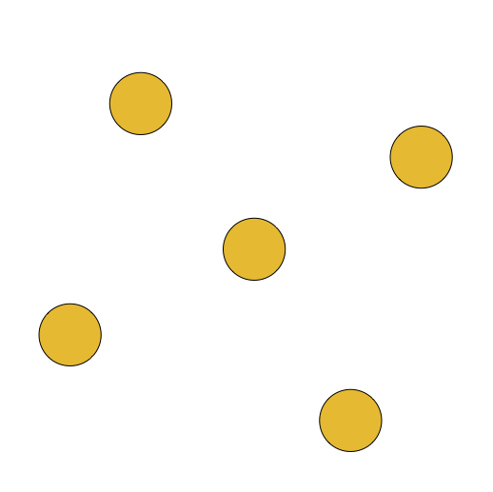
Challenges in Lithography Modeling
Rigorous simulation: physics-based simulation, e.g., Synopsys S-Litho
Rigorous Simulation
Mask Layout
Accurate but slow
Resist Pattern
Simulating 2 μm × 2 μm using Synopsys S-Litho ⟹ ~1 minute
A 2 mm × 2 mm chip contains 1M such clips ⟹ 1.9 years!
Intel Ivy Bridge 4C: 160 mm²
Notes:
Lithography simulation takes mask design as input and simulates the printed resist patterns obtained by lithography system.
Rigorous simulation precisely simulates the physical effects behind litho system
However, it is computationally expensive.
Let’s have a simple example.
rigorous simulation requires about 1 min to compute for about one 2x2 micron clip.
A 1x1 millimeter clip contains 250K such clips, which not affordable at all.
Let alone a real chip like Intel Ivy Bridge is much larger.
Rigorous simulation is used only in final verification and industry relies on massively parallel computing to real

Slide 5
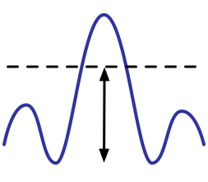
Challenges in Lithography Modeling
Rigorous simulation: physics-based simulation, e.g., Synopsys S-Litho
Rigorous Simulation
Mask Layout
Accurate but slow
Resist Pattern
Compact model: e.g., Mentor Calibre
Optical
Model
Resist
Model
Threshold Processing
Mask Layout
Aerial Image
Slicing Threshold
Resist Pattern
Sacrifices accuracy for speed
Notes:
To this end, most of the time, compact model is used for fast prediction with a small scarify in accuracy.
It first uses an optical model to calculate the intensity of light finally reaching the photoresist given the mask layout.
This light intensity map is called aerial image.
Then a resist model is used to determine the slicing thresholds.
Lastly, the thresholds are processed through extrapolation to generate the resist contours.

Slide 6
Challenges in Lithography Modeling
Rigorous simulation: physics-based simulation, e.g., Synopsys S-Litho
Rigorous Simulation
Mask Layout
Accurate but slow
Resist Pattern
Machine learning for resist modeling [Watanabe+, SPIE’17] [Shim+, SPIE’17] [Lin+, TCAD’18]…
Optical
Model
Machine
Learning
Threshold Processing
Mask Layout
Aerial Image
Slicing Threshold
Resist Pattern
Further speeds up resist modeling stage
Notes:
To further improve simulation speed, machine learning based techniques have been explored to construct efficient resist models.
regression model
But as one can clearly see it,
the proposed resist models rely on optical simulation to generate aerial images, which are accompanied by a high computational cost.
Additionally, only resist height or slicing threshold is predicted from the proposed models, which requires further processing to finalize the contour patterns.
Considering the fact that machine learning is successful in one stage
based approaches have demonstrated superior efficacy in a particular stage during lithography modeling

Slide 7

Challenges in Lithography Modeling
Rigorous simulation: physics-based simulation, e.g., Synopsys S-Litho
Rigorous Simulation
Mask Layout
Accurate but slow
Resist Pattern
Machine learning for end-to-end lithography modeling
Machine Learning
Mask Layout
Resist Pattern
Goal: ultimately fast modeling
Notes:
our goal is ultimately fast modeling through adopting machine learning for end-to-end lithography simulation
So here is the question we are asking, can we skip the expensive litho-simulation and obtain printed resist patterns in super fast?
To put it simply, the answer is LithoGAN...
With lithogan we leverage recent advancements in AI, particularly generative adversarial learning to generate virtually simulated silicon image in no time and without running detailed optical simulations.
With such a shortcut from layout to printed image, physical verification, mask synthesis and design closure are taken to new unprecedented level of acceleration

Slide 8
LithoGAN: End-to-End Lithography Modeling
Apply recent AI breakthrough, GAN/CGAN to generate “virtually simulated” silicon image
Without going through detailed optical and resist simulations
Significant speed up for physical verification, design/manufacturing closure
Machine learning for end-to-end lithography modeling
Machine Learning
Mask Layout
Resist Pattern
Goal: ultimately fast modeling
Notes:
our goal is ultimately fast modeling through adopting machine learning for end-to-end lithography simulation
So here is the question we are asking, can we skip the expensive litho-simulation and obtain printed resist patterns in super fast?
To put it simply, the answer is LithoGAN...
With lithogan we leverage recent advancements in AI, particularly generative adversarial learning to generate virtually simulated silicon image in no time and without running detailed optical simulations.
With such a shortcut from layout to printed image, physical verification, mask synthesis and design closure are taken to new unprecedented level of acceleration

Slide 9

Image Translation with Generative Adversarial Networks
Generative Adversarial Network (GAN) [Goodfellow et al, 2014]
Two neural networks contest (generator and discriminator)
Produces images similar to those in the training data set
Notes:
In fact, Yann LeCun
move

Slide 10
Image Translation with Generative Adversarial Networks
Generative Adversarial Network (GAN) [Goodfellow et al, 2014]
Two neural networks contest (generator and discriminator)
Produces images similar to those in the training data set
Notes:
In fact, Yann LeCun
move

Slide 11
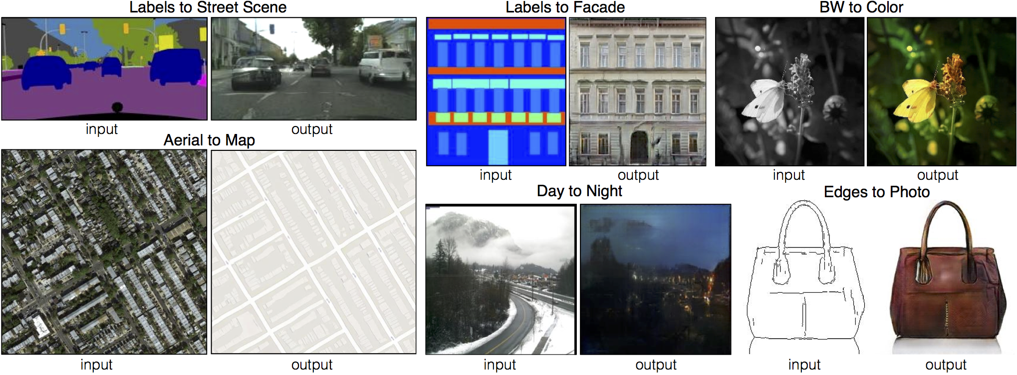
Image Translation with Generative Adversarial Networks
Generative Adversarial Network (GAN) [Goodfellow et al, 2014]
Two neural networks contest (generator and discriminator)
Produces images similar to those in the training data set
Conditional GAN (CGAN) for Image Translation [Isola et al, CVPR’17]
Takes an image in one domain and translate it to another one
Notes:
In fact, Yann LeCun
move

Slide 12
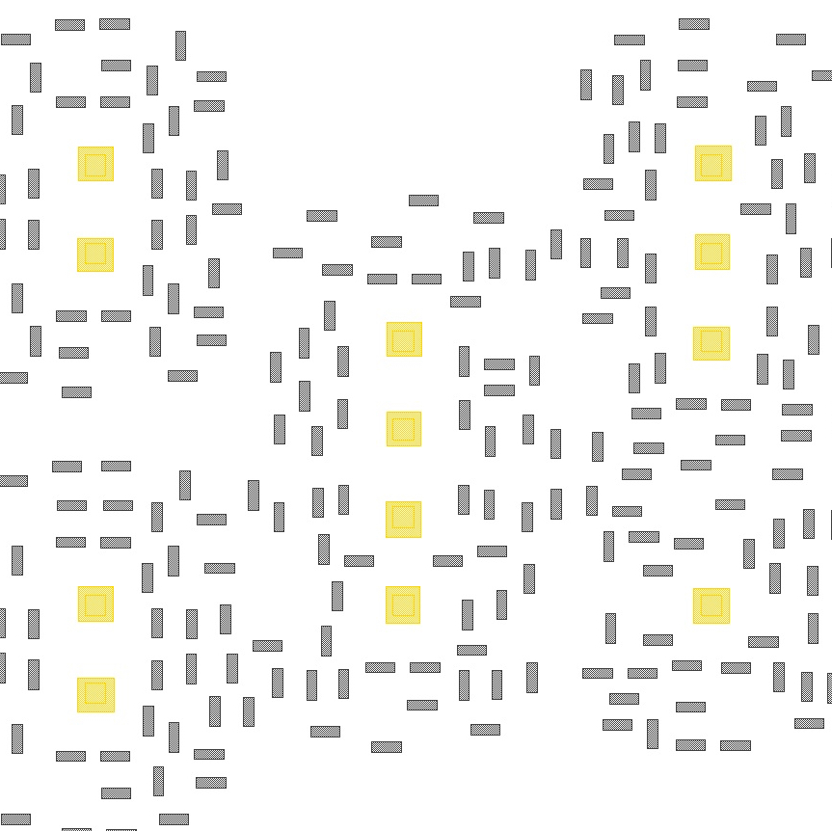



Image Translation for Lithography Modeling
1 µm
128 nm
128 nm
1 µm
Expensive Litho Simulation
256 px
256 px
256 px
Fast Image Translation
256 px
Different elements encoded on different image channels
Resist pattern zoomed in for high-resolution/accuracy
Notes:
Few things need to be considered to properly cast this problem to an image translation task suitable for CGAN
Litho simulation takes a large metrology window but only simulates the center area with high accuracy.
Simlary, we cosider the center resist pattern here.
In the mainstream 193nm lithography, litho influence window for a layout pattern of interest, e.g., contact in our case, is about 1 µm × 1 µm. That is, the elements not in this window has a slight effect on resist development.
Hence, we scale this window to an RGB image, with different elements encoded on dfferent image channels.
Meanwhile, we use a smaller window to capture the details of center resist contour. In this way, resist pattern is zoomed in for high resolution
As we can see, the resist pattern is irregular round shape.
For this type of images with smooth(sharp) low-frequency details
, GANs has demonstrated impressive results, which further motivates us to leverage it to perform litho modeling using FAST image translation
--------------------------------
To properly handle this task, we process mask and resist patterns in the following way
We use a 1um by 1um window centering the contact of interest towards better localization.
Different elements encoded on different image channels.
on the contrary, a much smaller window, that is 128 nm by 128 nm, is used to zoom-in the resist pattern corresponding to the contact of interest.
The processed pair of images or 256 pixel in each dimension.
-------------------------------
A mask area which is larger than the target area by the optical radius is necessary in order to calculate an aerial image accurately. If given a 1um mask clip, only a center contact can be simulated properly in both the rigorous simulation and the aerial simulation.
For mask patterns, proper resolution enhancement techniques (RETs) such as sub-resolution assist feature (SRAF) generation and OPC have been applied to the original input mask clips of size 2 × 2 μm.
Towards a better localization around the target contact, these clips are then cropped to 1 × 1 μm such that, in each clip, the target contact is located exactly at the center of the clip.
The obtained clips are converted to RGB images of size 256 × 256 pixels
where the target contact of interest is encoded into the green channel,
neighboring contacts are encoded into the red channel, and SRAFs are encoded into the blue channel.
This coloring scheme maps the different types of objects to different colors to help the model discriminate these objects during the learning and inference processes.
On the other hand, the target contact is designed to be 60 × 60 nm; hence, we use the window size 128 × 128 nm to crop the golden resist pattern of the target contact.
And similarly, we focus on the center contact only
with such a smooth low frequency image

Slide 13
CGAN for Lithography Modeling
$$\min_{G}\max_{D}𝔼_{x,y}\left[logD(x,y)+log(1−D(x,G(x)))+λ⋅∥y−G(x)∥_{1}\right]$$
Real pair
Fake pair
Notes:
The generator generates a fake resist pattern G(x) when fed with the input mask pattern x. The discriminator is responsible for classifying this image pair (x,G(x)) as fake, and meanwhile, it needs to predict the image pair (the mask pattern x, and the golden resist pattern y) as real.
where l1 norm is used to quantify the pixel-wise difference between the generated image and the ground truth.
[click]
After the GAN model converges, the role of the discriminator is over, and the main interest is in the generator who is now able to generate high-quality images.
------------------------
Here, “real” means that y is the output image corresponding to input x. In other words, the target contact in x after resist development will become y.
The competition throughout the training process drives both to improve: the discriminator guides the generator on what images to create, and while also improving itself by learning what distinguishes real images from the fake ones from the generator.
At the end of the training process, the generator learns the distribution of the training data and is eventually able to generate real-looking images.

Slide 14
LithoGAN
Prediction
Inference using trained generator in CGAN
Ground truth
Generator output
Dual learning framework
Notes:
Shape recovery is accurate, however, centering can be further improved
In fact, we are interested in predicting a resist pattern which is accurate in both the shape and center. Here the center refers to the center of the bounding box enclosing the resist pattern.
Hence, we propose a dual learning framework, referred to as LithoGAN, which splits the modeling task into two objectives:
• Resist shape modeling: a CGAN model is used to predict the shape of the resist pattern while neglecting the center;
• Resist center prediction: a CNN model is used to predict the center location of the resist pattern.
Later, the shape generated by CGAN is adjusted by recentering the resist shape based on center the coordinates predicted from the CNN.
----------------------
For the lithography modeling task, the center of the generated resist pattern is as important as the shape of the pattern.
For traditional computer vision tasks, locations of the objects in the generated image are not a major concern. For example, when trained to generate car images, the output of the GAN is judged upon based on the quality of an image as seen by a human while neglecting the exact location of the car in the image.
However, it is evident that CGAN falls short of predicting the correct center location of the resist pattern while demonstrating excellent results predicting the shape of the pattern.

Slide 15
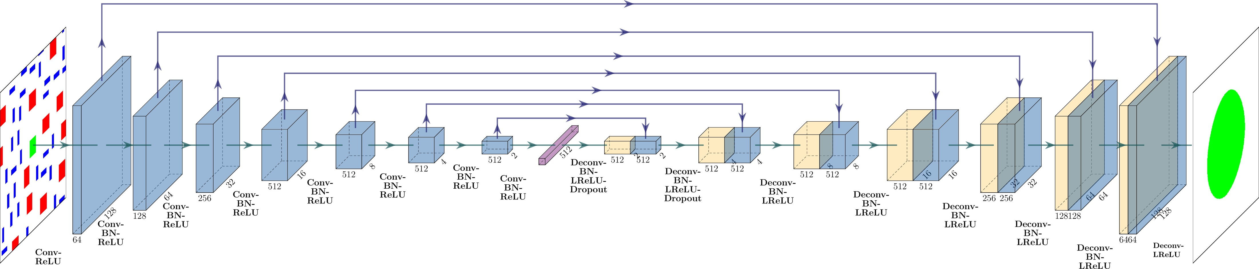
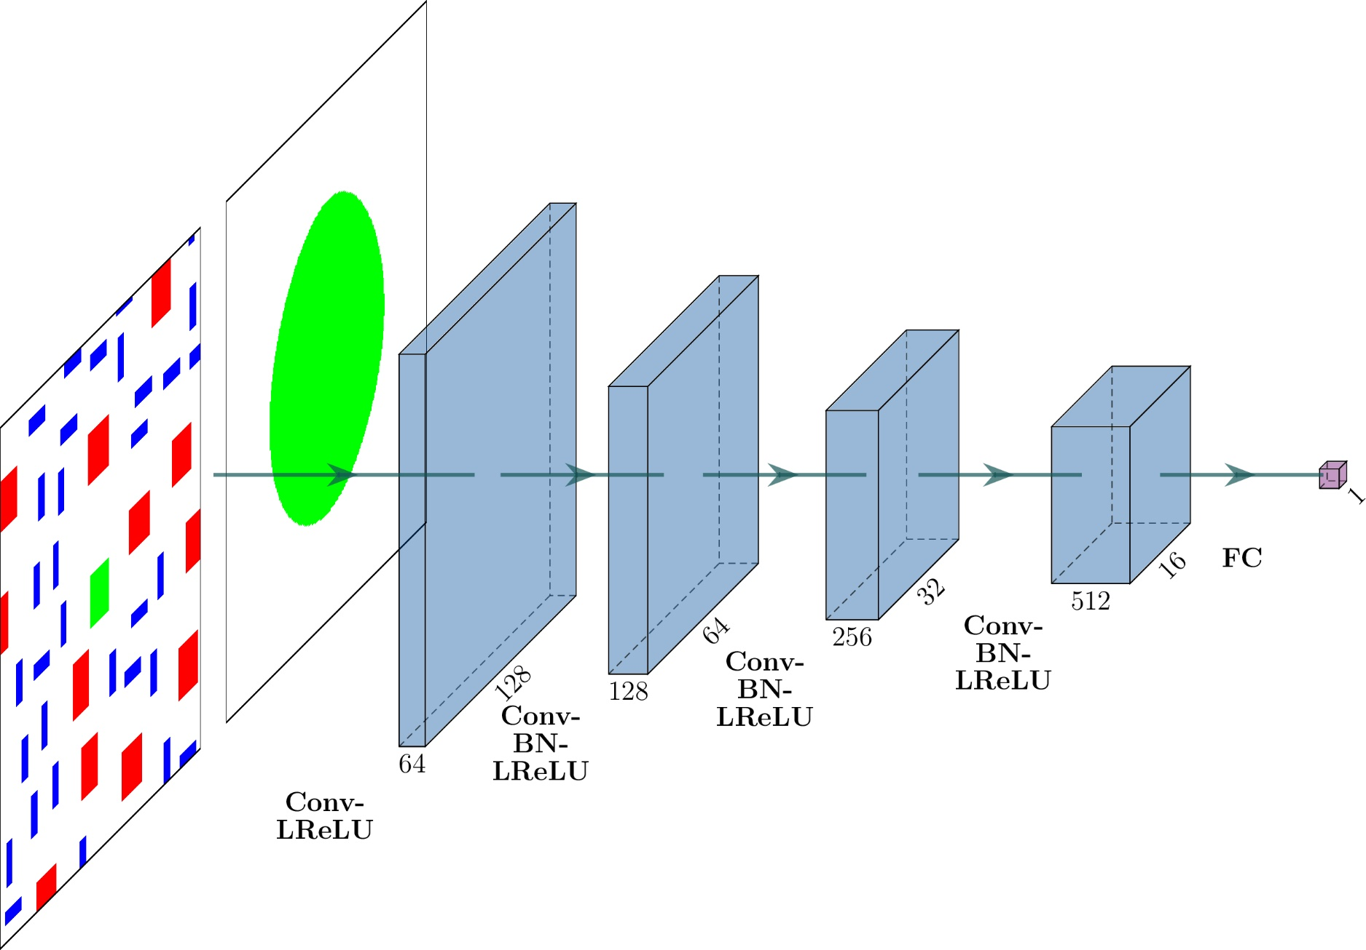
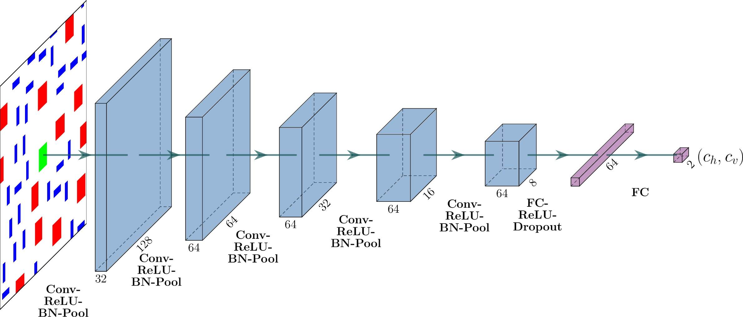
LithoGAN Architecture
Generator
Encoder
Decoder
Discriminator
CNN for center prediction
Notes:
The generator and discriminator design are similar to that of DCGAN.
Convolutional downsampling and deconvolutional upsampling
To further enhance, we follow the practice of skip connections between encoder and decoder in cgan for image translation to shuttle information between two domains
typcial cnn
The key takeaways are:
Batch normalization is a must in both networks.
Fully hidden connected layers are not a good idea.
Avoid pooling, simply stride your convolutions!
ReLU activations are your friend (almost always).
Use Batch normalization except the output layer for the generator and the input layer of the discriminator.

Slide 16
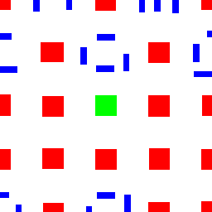
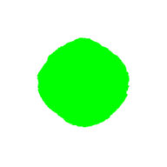
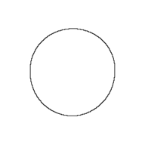
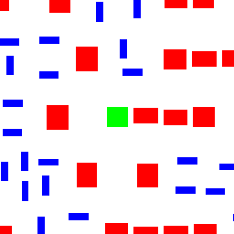

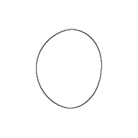
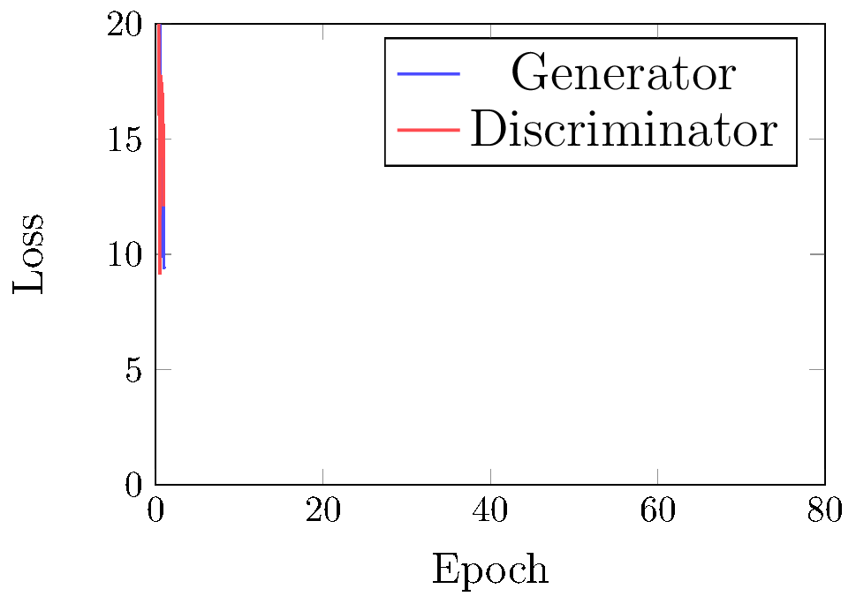
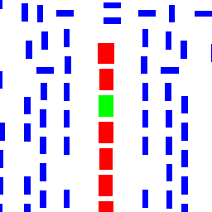

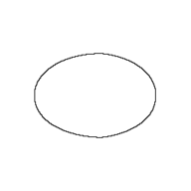
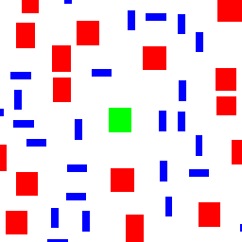
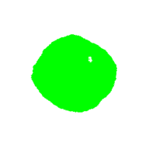
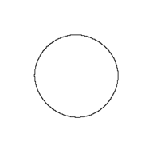
LithoGAN Visualization
Model advancement progress
Notes:
LithoGAN is stable after 50 epochs, and is able to generate high-quality resist patterns

Slide 17
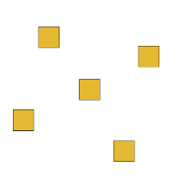
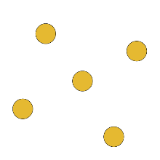
Experimental Results
Setup
Python w/ TensorFlow
3.3GHz Intel i9 CPU & Nvidia TITAN Xp GPU
1800X
Datasets
Different types of contact arrays [Lin+, TCAD’18]
982 mask clips at 10nm node (N10)
979 mask clips at 7nm node (N7)
75-25 rule for train/test split
190X
15h
95m
1X
Methods
Rigorous sim using S-Litho: golden resist patterns
[Lin+, TCAD’18]: Optical sim using Calibre + threshold prediction using CNN + post processing
30s
Optical
Model
Machine Learning
Threshold Processing
Compelling runtime speedup for early technology exploration
Mask Layout
Aerial Image
Slicing Threshold
Resist Pattern
Notes:
Our LithoGAN is eighteen hundred times faster than
One nighty times

Slide 18
Experimental Results
Accuracy measures
Edge Displacement Error (EDE)
The distance between the golden edge and the predicted one of the bounding boxes
The smaller, the better
Captures bounding box mismatch
IOU = Intersection/Union
The larger, the better
Captures contour mismatch
Competent accuracy for lithography usage (in consultation with industry)

Slide 19
Conclusions
LithoGAN
End-to-end lithography modeling
CGAN paired with CNN
Competent accuracy for lithography usage at advanced technology nodes
Compelling runtime speedup for early technology/design exploration
Further directions
Lithography modeling for complex 2D shapes
DFM with LithoGAN
Notes:
With the impressive results lithogan has achieved, our future goal is to capitalize on this to extend the framework towards modeling complex 2D shapes, and incorporating LithoGAN into the DFM flow

Slide 20
Thank you! Welcome to our poster for more details

